Slide 1
智能系统设计与应用 (2022 春季学期)
Case II:
Game Props Recommendation— with Multiple Instance Multiple Label Learning
主讲教师：詹德川

Slide 2
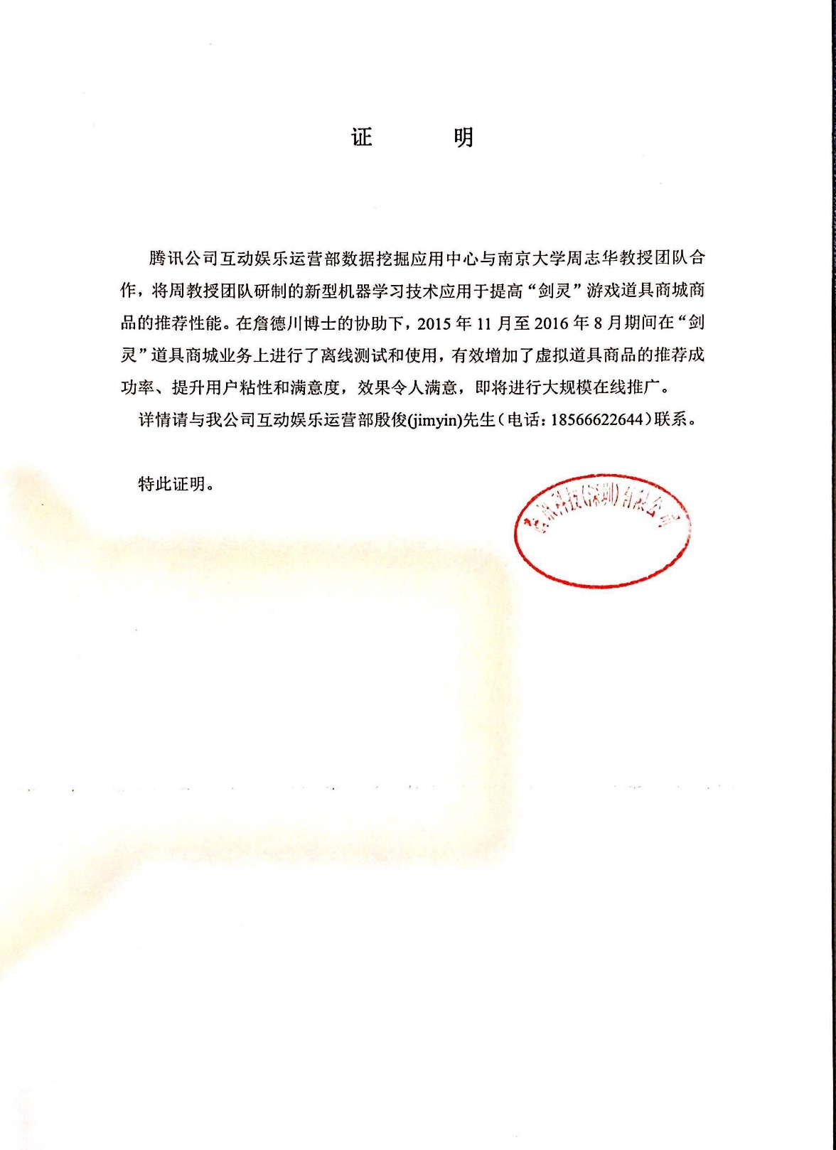

Project Sources
Project Source: Tencent/腾讯IEG
Tencent Rhino Bird Grants

Slide 3
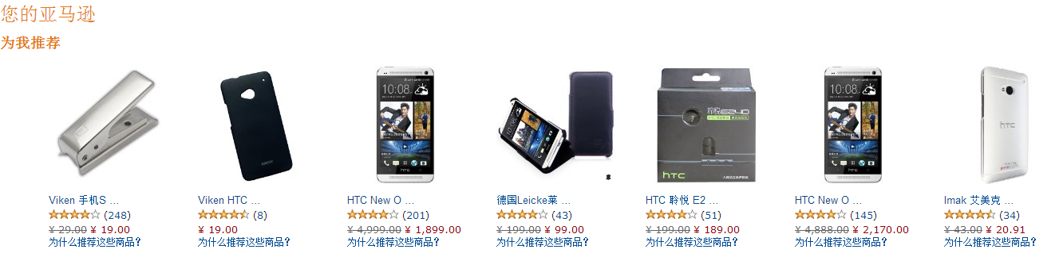

Ordinary Recommendation Systems

Slide 4
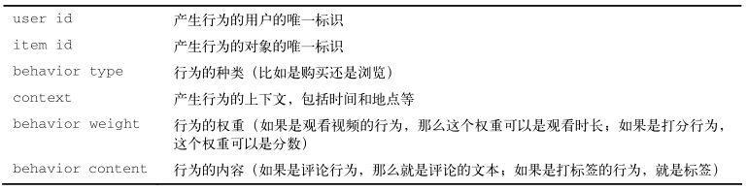
User-Item pairs
 | ITEM 1 | ITEM 2 | … | ITEM N
USER 1 | 0 | 1 | … | 1
USER 2 | 0 | 0 | … | 0
… | … | … | … | …
USER M | 1 | 0 | … | 1

Slide 5
Games Props Recommendation: Special Features
Complicated Dependency on Context (CDC)
Game props are not only dependent on the purchase activities of players but also heavily relevant to the elaborated game contexts
Long-Distance Intervention (LDI)
Player purchasing game props can be affected by events occurred long ago
Props priority-Role Dependency (P-RD)
There are lots of props in a certain game, while different types of characters
Concept Variation (CV)
The players may insist to obtain new props by playing games instead of purchasing.
Notes:
道具和特定角色相关；只能在相关环境触发购买等
道具合成；用户购买行为和用户的游戏经历相关等

Slide 6
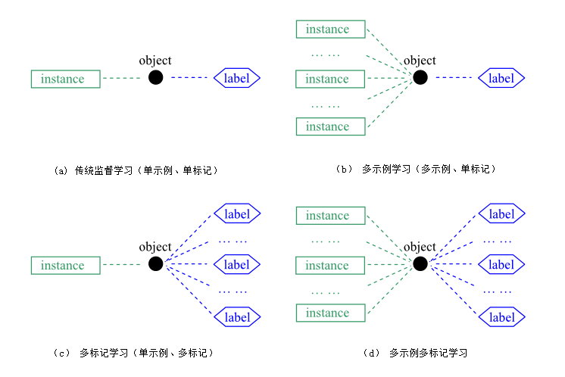
Games Props Recommendation as a Classification Problem
Modeling with Multi-Instance Multi-Label Learning
Text Categorization
Image Classification
Video Annotation

Slide 7
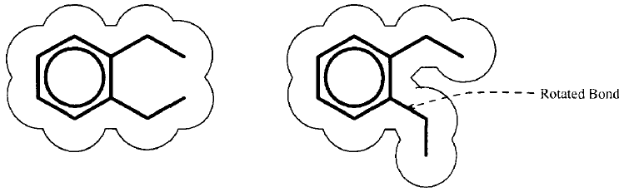
Origin of Multi-instance learning
A molecule may have many alternative shapes
……
Reprinted from [Dietterich et al., AIJ’97]
The Difficulty
Biochemists know that whether a molecule is qualified or not, but do not know which shape responses for the qualification

Slide 8
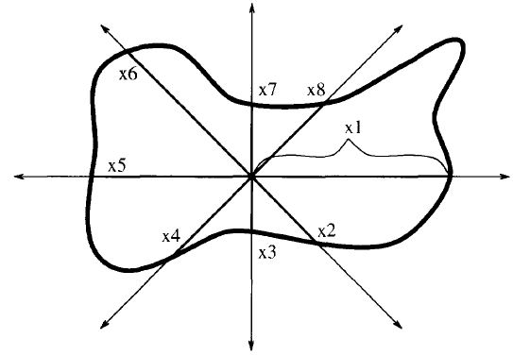
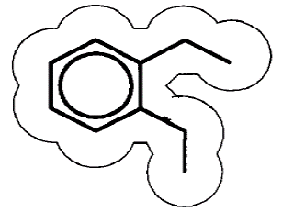
Origin of Multi-instance learning
shape
instance
molecule
bag
(feature vector)
……
……
Reprinted from
[Dietterich et al., AIJ’97]
A molecule corresponds to a bag of instances
A bag is positive if it contains at least one positive instance; otherwise it is negative
The labels of the training bags are known
The labels of the instances in the training bags are unknown

Slide 9
Formal Definition of MIL
Settings
feature space ;
label space
Inputs
multi-instance training set
is a bag of instances
is the number of instances in
is an instance
is the label of
is a positive bag (thus ) if there exists ,
is positive.
Yet the value of
index is unknown
Outputs
multi-instance predictive function:

Slide 10
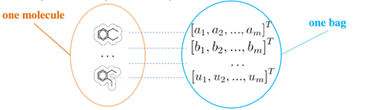

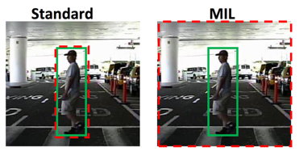

The Power of MIL
In many real-world applications, bag representation is a natural choice
Drug activity prediction
Image categorization
Text categorization
Pedestrian detection

Slide 11
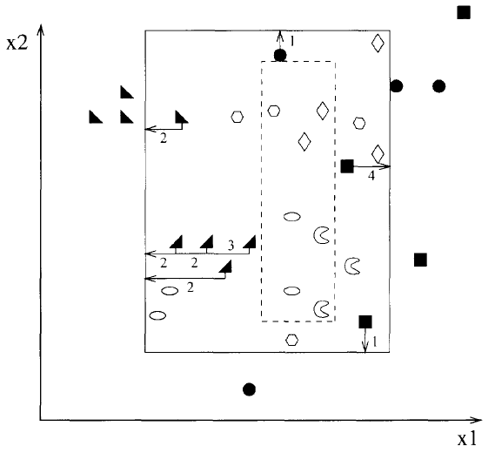
APR [Dietterich et al., AIJ’97]
APR (Axis-Parallel Rectangles) Algorithms
Instance-level classifier
An APR which encloses at least one instance from each positive bag and no instance of any negative bag
Three APR algorithms
standard, outside-in, and inside-out APR algorithms
best performance:
Iterated-discrim APR
on Musk1: 92.4%;
on Musk2: 89.2%
Specific to the drug activity prediction problem

Slide 12
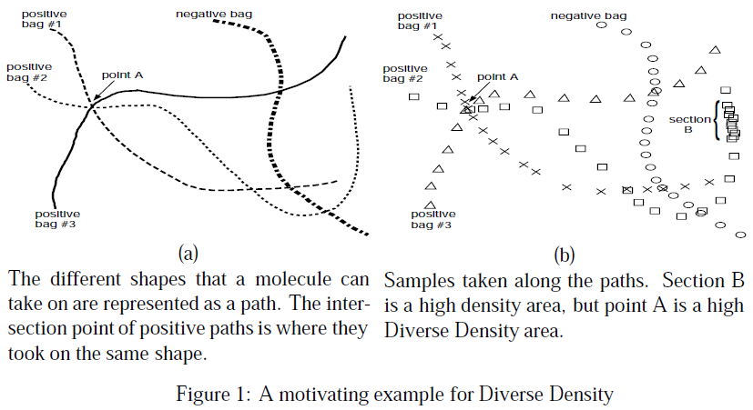
Diverse Density [Maron & Lozano-Pérez, NIPS’97]
Instance-level classifier
Target concept (point in the feature space) which maximizes the diverse density (DD) over the training bags, i.e. being near to instances of different positive bags and far from instances of all negative bags

Slide 13
Diverse Density (Cont.)
Probabilistic formulation of diverse density
[Assuming equal prior probability]
[Assuming conditional independence among bags]
[Assuming equal prior probability]
For positive bag:
Maximize DD by gradient search
For negative bag:

Slide 14
Generalized MIL (GMIL)
Standard MIL assumption
An underlying target concept which governs the prediction of class label on the bag :
GMIL assumption [Weidmann et al., ECML’03]
A set of underlying concepts which governs the prediction of class label on the bag :
presence-based:
threshold-based:
count-based:
number of instances in X with concept h_{i}
lower and upper threshold for concept h_{i}
Another GMIL formulation: assuming attraction concepts as well as repulsion concepts [Scott et al., TechRep’03; Tao et al., ICML’04; Tao et al., TPAMI’08]

Slide 15
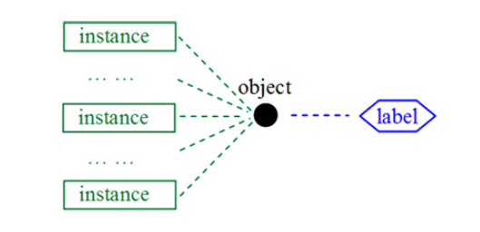
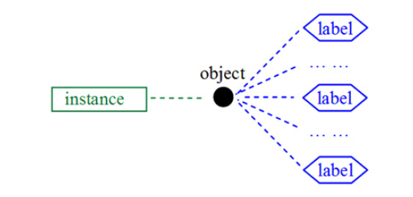
Multi-Instance Multi-Label Learning (MIML)
Multi-Instance Learning (MIL)
Multi-Label Learning (MLL) [Zhang & Zhou, TKDE’14]
Input Ambiguity
Output Ambiguity
object with many alternative input descriptions, i.e. instances
object with many alternative output descriptions, i.e. labels

Slide 16

MIML (Cont.)
Real-world objects are usually inherited with input ambiguity as well as output ambiguity
[Zhou et al., AIJ’12; Zha et al., CVPR’08; Briggs et al., KDD’12; Li et al., TCBB’12; Surdeanu et al., EMNLP’12; Wu et al., TCBB’14]
An image usually contains multiple regions each can be represented by an instance
The image can simultaneously belong to multiple classes
Elephant
Lion
Grassland
Tropic
Africa
… …

Slide 17
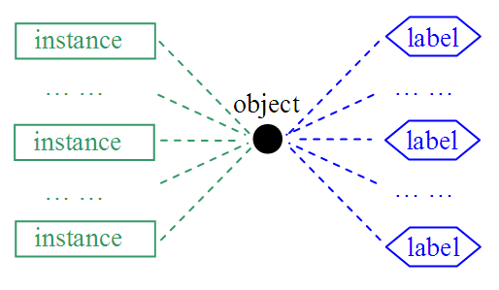
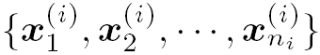
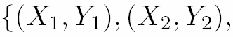
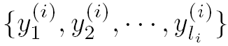
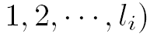
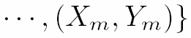
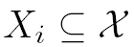
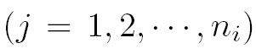
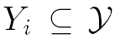
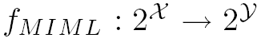
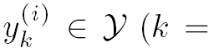
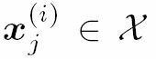
MIML (Cont.)
MIML task:
To learn a function
from a given data set
, where is a set of
instances ,
, and is a set of
labels ,
.
 - the instance space
 - the set of class labels
n_{i} - the number of instances in X_{i}
l_{i} - the number of labels in Y_{i}
More on MIML:
Zhou Z-H, Zhang M-L, Huang S-J, Li Y-F. Multi-instance multi-label learning. Artificial Intelligence, 2012, 176(1): 2291-2320.

Slide 18
Bag Generator for Multi-Instance
SBN (Single Blob with Neighbors)
Image (bag)
1
filtered and resized to 8x8
3
0
4
Blob: 2x2 patch
Instance
2
one blob with four neighboring blobs

Slide 19

Bag Generator for Multi-Instance (Cont.)
Blobworld
Components of the L*a*b* color space
extract
features
pixel features
The texture features
The pixel position
group
features
describe
regions
regions features
(instances)
image regions

Slide 20
Bag Generator for Multi-Instance (Cont.)
LBP (Local Binary Patterns)
Image (bag)
35 sliding windows
Instance
58-dimensional LBP descriptors
SIFT (Scale Invariant Feature Transform)
Image (bag)
40 keypoints
Instance
128-dimensional SIFT descriptors

Slide 21
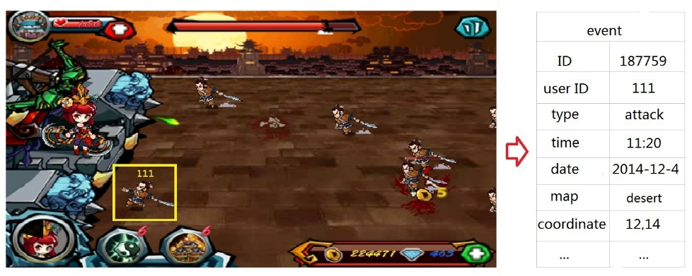
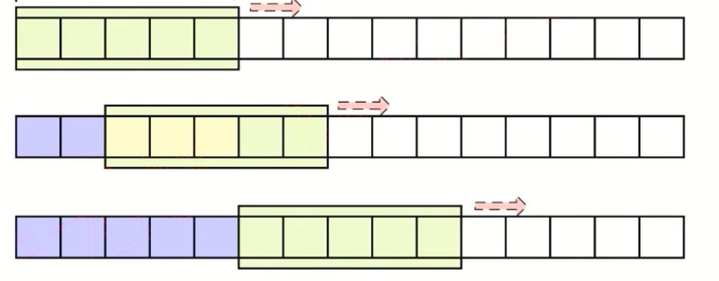
Game Props Recommendation with logs Solution to Multi-Instances
Logs (types and values)
SBN style bag generator
Or ?

Slide 22
Game Props Recommendation with logs Solution to Multi-Instances
Prop-event relationship
Prop relationship (Multi-Props)

Slide 23
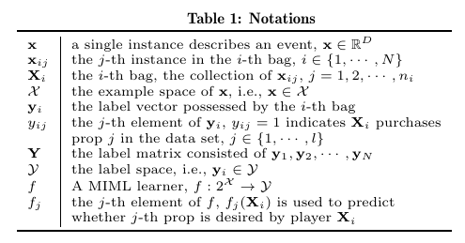
Game Props Recommendation with logs Solution to Multi-Instances
Multi-Props
A “new” created projected representor
Props-Events
Relationship
Original Multi-Instance Assumption

Slide 24
Game Props Recommendation with logs Solution to Multi-Labels
Props Relationship
Learning with ranking
Desired props should be assigned with larger predictive value
Note that j is the fixed variable, i.e., in total, k props are placed in wrong slots
Should be a penalty incurred by placing k irrelevant elements before a relevant one

Slide 25
Game Props Recommendation with logs Solution to Multi-Labels
Learning with ranking
This is a distribution or probability of wrong placed prop
However, the ranking error defined with l* is non-convex and discontinuous, and could be rather difficult to optimize directly
Hinge style Loss
A upper bound of the original loss

Slide 26
Game Props Recommendation with logs A Fast Algorithm
Prop-event relationship
Prop relationship (Multi-Props)
Computational cost?

Slide 27
Game Props Recommendation with logs Solution to Multi-Labels
MIML-fast
SGD due to the limitations on computation resources
Update rules for parameters

Slide 28
Game Props Recommendation with logs Variants to Special Features: PLC and We-MIML
Product Life Cycles (PLC): a statistical phenomenon of players behaviors
When there are only a few players, game carries have to increase the investments on advertising, since recommendation systems, which focus on targeted ads., usually doesn't work
When there are a considerable amount of players, especially paying players, and the Average Revenue Per Player (ARPP) can be maintained to a certain degree, the game enters into the expansion phase
Here by attributing the concept variation problem to the drift of class priors, we first put forward a prior re-weighting solution here
We-MIML
first calculate the most recent “class priors” in a time window, and use the temporary class priors to “weight” the base learner described in previous section.

Slide 29
Game Props Recommendation with logs Variants to Special Features: Sparsity and Sp-MIML
Sparse Prediction Solution (SPS): A common requirements in recommendation system
Assumption:
Similar users will have similar evaluation scores on certain items
Similar items will attract similar customer groups
Sparse assumptions can be made on the multi-label predictors:

Slide 30
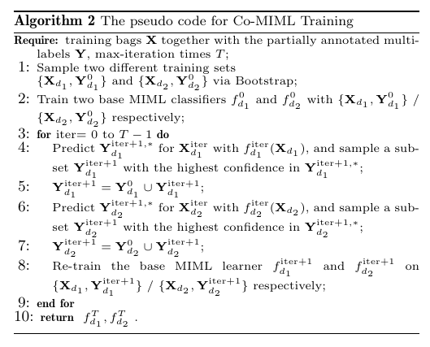
Game Props Recommendation with logs Variants to Special Features: Hidden Intentions and Co-MIML
Purchase Intentions:
Fact: one player not buying prop doesn't indicate his disinterest in the certain prop
A lot of Unlabeled Data!

Slide 31
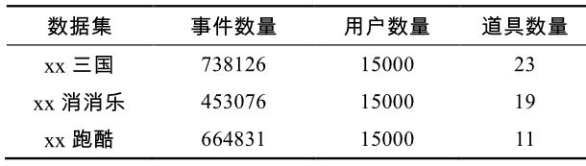
Benchmarks on Phone Games
对比方法
随机（Random）
最热门推荐（Most Popular）
基于用户的协同过滤（User-CF）
基于物品的协同过滤（Item-CF）
基于奇异值分解的推荐（SVD++）
隐语义模型（LFM）
数据集

Slide 32
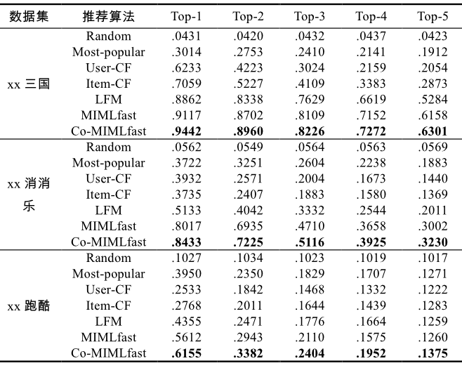
Benchmark results on Phone Games

Slide 33
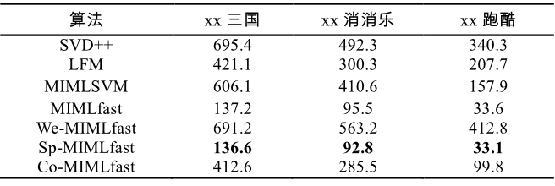
Benchmark results on Phone Games
模型训练时间对比（秒）

Slide 34
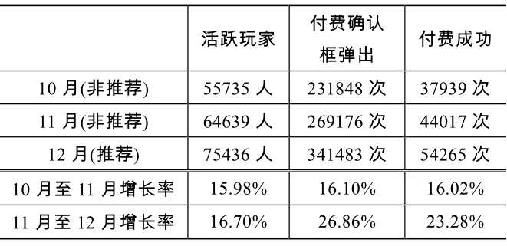
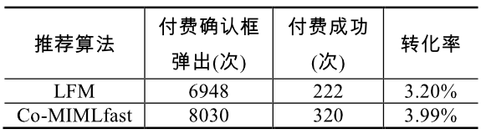
Benchmark results on Phone Games
运营数据统计
计算ARPU(average revenue per user)值可知，推荐系统获得了5.7%的营收增长

Slide 35

前往下一站……

